Slide 1
Agenda
Review of the Components of Technical Descriptions
Introduction of Technical Definitions
Review of partitioning an object
What’s next...

Slide 2
Creating Technical Descriptions
Defining the product/process.
Partitioning the object.
Identifying major and minor components.

Slide 3
Organizational Model of Technical Descriptions
Title
Introduction
Major Part
Major Part
Conclusion
Definition of subject
Main Point
Importance of Subject
Overall Description
List of Major Parts
Definition and Purpose of Part
Minor Part
Minor Part
Etc (repeated as needed)
Definition and Purpose of Part
Minor Part
Minor Part
Etc (repeated as needed)
Importance of Subject
Future of Subject
One Operating Cycle
Purpose Statement
Specific
Precise

Slide 4
Microgenre: Technical Definitions
A Basic Definition (Sentence Definition) Has Three Parts
Term being defined
Category in which the term belongs
The distinguishing features that differentiate it from its category
An Extended Definition Starts with a Sentence Definition and Then Expands on It
Notes:
Extended definition expands on a sentence definition in the following ways:
Word history and etymology
Examples
Negation (explain what the subject is not)
Division into parts
Similarities and differences
Analogy
Graphics

Slide 5
Expanded Definitions
Starts with sentence definition
Uses other ways of defining such as...
Word history & etymology
Examples
Negation
Division into parts
Similarities & differences
Analogy
Graphics

Slide 6
Sample Extended Definiton
How many different types of extended definitions are used in the following example?
Discuss, list & categorize them.
Be prepared to share your findings with the class.

Slide 9
Partition
By features
By functions
By stages of a process

Slide 10
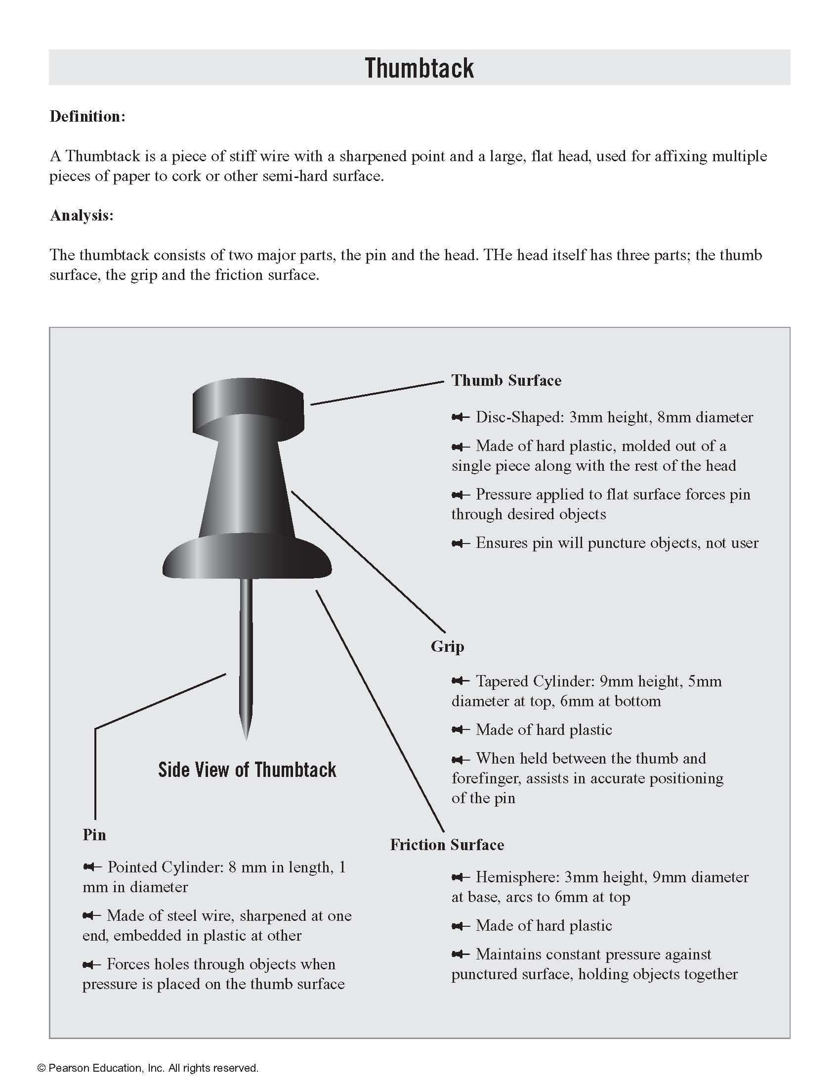

Slide 11
What’s next...
Your team should have already decided on the camera you will be describing.
Divide the work load.
Partition the subject.
Identify the major and minor parts
Decide the level of specificity needed for your audience
Create the illustration, line drawings or photographs that you will use in your description.
Write a definition of your product, using one or two of the extended definition techniques in addition to a straight denotative definition of the object.

Slide 12
Unit 6 Assignments: See Arisoph for details
For Tuesday, first draft of technical description is due in class (can be shared Google doc)
Team Assignment: Create a technical description and Memo
Due Friday, November 15, 11:55 p.m.
Individual Audience Analysis Reflection
Due Sunday, November 17, 11:55 p.m.
Reading Check (individual assignment) Due November 17, 11:55 p.m.

